Slide 1
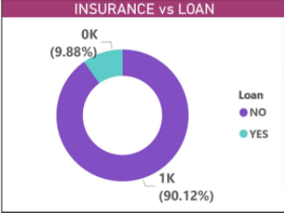
CAR INSURANCE PRIMARY DATA
This is insurance vs loan Donut chart ,where we can observe that out of total insurance opting customer , 90 % customers are those who have not taken any loan, only ~10% customers have taken the loan

Slide 2
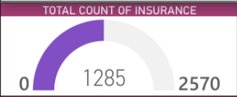
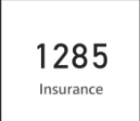
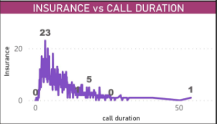
This is gauge chart of count of insurance where we can compare the target value with achieved value. Out of total 2570 customers ,only 1285 customers have taken the loan.
This is line chart for insurance vs call duration ,here we see that in call duration of b/w
2 minute- 14 minute , most of the customer have been convinced for insurance. In call duration =3.5 minute , 23 customers(highest) have been convinced.

Slide 3
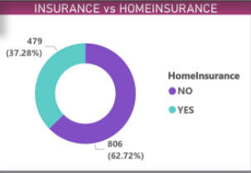
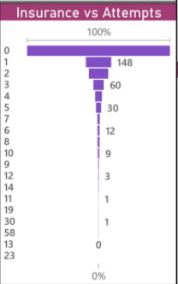
This is donut chart of car insurance vs home insurance , here we can observe that out of total insurance opting customer 72.72% customers are those who had not any home insurance, 37.28% customers have home insurance.
This is funnel chart of insurance vs attempts where we can see that 95% customers was convinced in less than 2-3 attempt of contact.

Slide 4
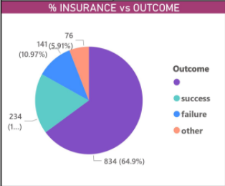
This is pie chart of insurance vs outcome where we can see that for total insurance opting customers 64.9 % customers have null output, 18.21% customers have output as success in campaign ,10.97% customer belong failure outcome, 5.91% customers belong to other outcome of campaign.

Slide 5
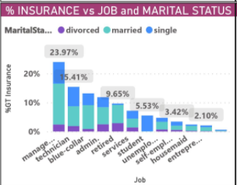
This is stacked column chart of insurance vs job designation and marital status. Here we
can see that customers having management job are in highest percentage(23.97%) of count in insurance opting. The customer who are entrepreneur present in least number of taking insurance.
We can also see that the percentage of married customer are more than any other marital category. In management job category 15.41 % of total customer are married.

Slide 6
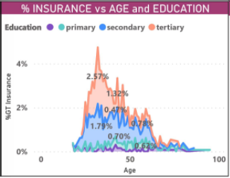
This is area chart. The customer whose ages in between 26-46 are more in number in taking the insurance. The customers whose age is 32 are highest in percentage (~ 5%) and their education is belonging to tertiary category.

Slide 7
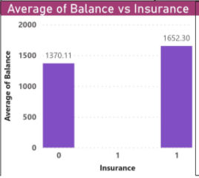
This is stacked column chart where we can easily see that customers who have taken the insurance has more average balance as compare to those who are not opting the insurance.

Slide 8
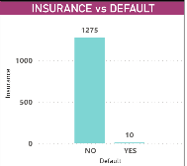
This is column chart of insurance vs default. Here we can see that out of total 1285 insurance opting customer 1275 are not default, only 10 customer are default

Slide 9
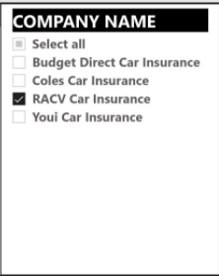
SECONDARY DATA CUSTOMER REVIEW
This is the slicer in which we can select the company name and get the chart only corresponding to the company ,if we select the all we will get chart of combining all 4 companies data.

Slide 10
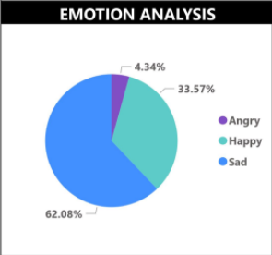
This is the pie chart showing emotional analysis in three phase of emotion 1. Angry
2. Happy 3.Sad in percentage. It shows emotion corresponding to the company which has been selected.

Slide 11
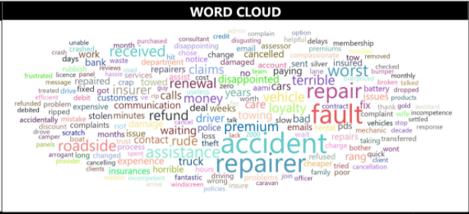
This is cloud chart representing the most important word in text review given by the customer for the company which has been selected in the slicer.

Slide 12
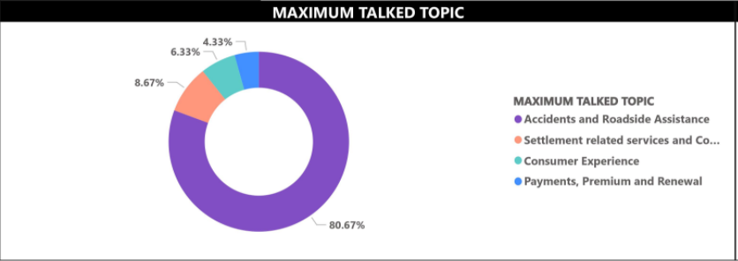
This is the donut chart representing the maximum talked topic by the customer in a company which has been selected. The maximum talked topic categorise in 4 section
Accident and roadside assistance
Settlement related service and communication
Consumer experience
Payment, premium and renewal

Slide 13
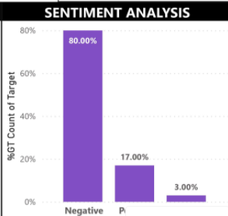
This is the stacked bar chart showing the sentiment analysis of review given by customers of a particular company which has been selected. The sentiment has 3 category 1. Negative 2. Positive 3. Neutral, its count is represented by height of the bar.

